Slide 1



Python 3 Beginner
Chapter 00
Previously, on Python 3 Beginner…
release 1.0.0
37/39 Avenue Ledru Rollin – CS 11237 – 75750 PARIS CEDEX 12 - info@valnaos.com – www.valnaos.com Tél : 01 86 95 20 48

Slide 2

What we saw last time
Python 3 Beginner
The Python interpreter and how to use it in Google Colab
Displaying text with the print function
Capturing text from the user using the input function
Numeric types int, float and complex and mathematical operators.
Text type str, indexing and ranges with [], and format strings
Converting from one type to another

Slide 3

Where? Who?
Python 3 Beginner
Class Material
GitHub: https://github.com/cstar-industries/python-3-beginner
Instructor
Charles Francoise <charles@cstar.io>

Slide 4

Session Objectives
Python 3 Beginner
At the end of this session, you will be able to:
Use the Python interpreter to perform simple mathematical operations.
Output any text using Python.
Capture text input from the user.
Store and retrieve information from variables.
Use numeric types int, float and complex and perform deeper math.
Manipulate text data using the str type.
Start using the Python interpreter on your own.

Slide 5
Session Syllabus
Python 3 Beginner
Chapter | Subject | Start | End | Total Time (in hours)
00 | Course Introduction | 14:00 | 14:30 | 00:30
01 | Python interpreter basics | 14:30 | 15:15 | 00:45
02 | Data types and operators: Part I | 15:15 | 16:00 | 00:45
 | Coffee Break | 16:00 | 16:15 | 00:15
03 | Data types and Operators: Part II | 16:15 | 17:00 | 00:45
04 | Work session: Variables, numbers and strings | 17:00 | 18:00 | 01:00
 | Total |  |  | 04:00

Slide 6

Cloud Technology Associate
Copyright © 2018 | 9
Q&A
37/39 Avenue Ledru Rollin – CS 11237 – 75750 PARIS CEDEX 12 - info@valnaos.com – www.valnaos.com Tél : 01 86 95 20 48

Slide 7
Python 3 Beginner
Chapter 01
Conditional flow “if – else”
release 1.0.0
37/39 Avenue Ledru Rollin – CS 11237 – 75750 PARIS CEDEX 12 - info@valnaos.com – www.valnaos.com Tél : 01 86 95 20 48

Slide 8
Representing “nothing” in Python
Python 3 Beginner
Special datatype NoneType
Only one value: None
Used to represent the absence of a value (e.g. when a function returns nothing)
Similar to null or void in other languages
a = None
print(a)
None

Slide 9
Boolean type
Python 3 Beginner
bool is a type to contain the Boolean notion of truth
Two possible values: True/False (watch out for the capitals!)
Use the not operator to negate the value
 | False | True
not | True | False

Slide 10
Boolean operators
Python 3 Beginner
Boolean values can be combined using Boolean arithmetic operators: and / or
and | False | True
False | False | False
True | False | True
or | False | True
False | False | True
True | True | True

Slide 11
Boolean operators
Python 3 Beginner
Just like mathematical and string operators, Boolean operators can be prioritized by parentheses
Watch out for unexpected operator precedence effects! When in doubt, always make your intent explicit with parentheses.
⚠️
👍
print(True or True and False)
print(True or (True and False))
False
True

Slide 12
Let’s write some code!
Python 3 Beginner
print(False or False)
print(False or True)
print(True or False)
print(True or True)
False
True
True
True
Notes:
* The `print` function outputs whatever we tell it to

Slide 13
Comparison operators
Python 3 Beginner
Comparison operators generate a Boolean value by comparing two values
Equality: == / Inequality !=
Greater than: > / Lower than: <
Greater than or equal: >= / Lower than or equal: <=
print(1 == 2)
print(1 < 2)
print('toto' == 'toto')
False
True
True

Slide 14
More comparison operators
Python 3 Beginner
Identity: is / is not
Inclusion: in / not in
a = 'Hello World!'
print('x' in a)
print('W' in a)
b = 'Hello World!'
print(a == b)
print(a is b)
False
True
True
False

Slide 15
Complex boolean expressions
Python 3 Beginner
Combine comparison results with boolean operators
a = 13
(a > 0) and ((a % 2) == 0)
False
Chain comparison operators left to right
x op1 y op2 z ⬄ (x op1 y) and (x op2 z)
a = 13
0 < a < 15
True

Slide 16
Let’s write some code!
Python 3 Beginner
a = 'Hello World!'
b = 'Hello World!'
print(a == b)
print('h' in a)
print('H' in a)
print('Hell' in a)
True
False
True
True
Notes:
* The `print` function outputs whatever we tell it to

Slide 17
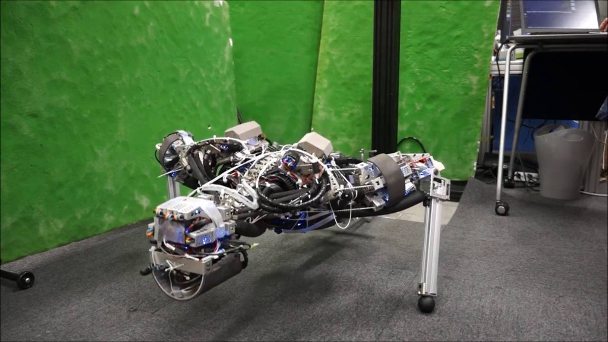
Workout Time!
Python 3 Beginner
Chapter 1 Exercises link
Notes:
https://github.com/cstar-industries/python-3-beginner/blob/master/001-First-Steps/First%20Steps%20-%20Chap%2001%20-%20Exercises.ipynb

Slide 18
Chapter Summary
Python 3 Beginner
This chapter covered the following:
The history of the Python language and the philosophy behind it.
Writing code directly into the Python interpreter shell.
Outputting text using the print function.
Saving data to variables.
Capturing user input from the keyboard using the input function.

Slide 19
Python 3 Beginner
Chapter 02
Data types and operators: Part I
release 1.0.0
37/39 Avenue Ledru Rollin – CS 11237 – 75750 PARIS CEDEX 12 - info@valnaos.com – www.valnaos.com Tél : 01 86 95 20 48

Slide 20
Basic number types
Python 3 Beginner
Two main numeric types in Python
int for integers
float for rational numbers (“floating point”)
Integers have infinite precision
Floating-point limited to IEEE-754 “double-precision” (64-bit)

Slide 21
Let’s write some code!
Python 3 Beginner
print(1)
print(0.5)
print(1 / 2)
print(3 ** 4)
1
0.5
0.5
81

Slide 22
Basic mathematical operations
Python 3 Beginner
Addition, subtraction, multiplication, division
+, -, *, /
Python respects mathematical order or operations
Use parentheses to change priority
You can nest parentheses
(2 * (1 + 2)) ** 2
36

Slide 23
More mathematical operations
Python 3 Beginner
Exponentiation: **
Integer division: //
10 // 3
3
Remainder (modulo): %
10 % 3
1

Slide 24
Deeper math
Python 3 Beginner
Python has a complex type
3+2j
Absolute value: abs
The math library contains many mathematical functions (sqrt, sin, cos…)
import math

Slide 25
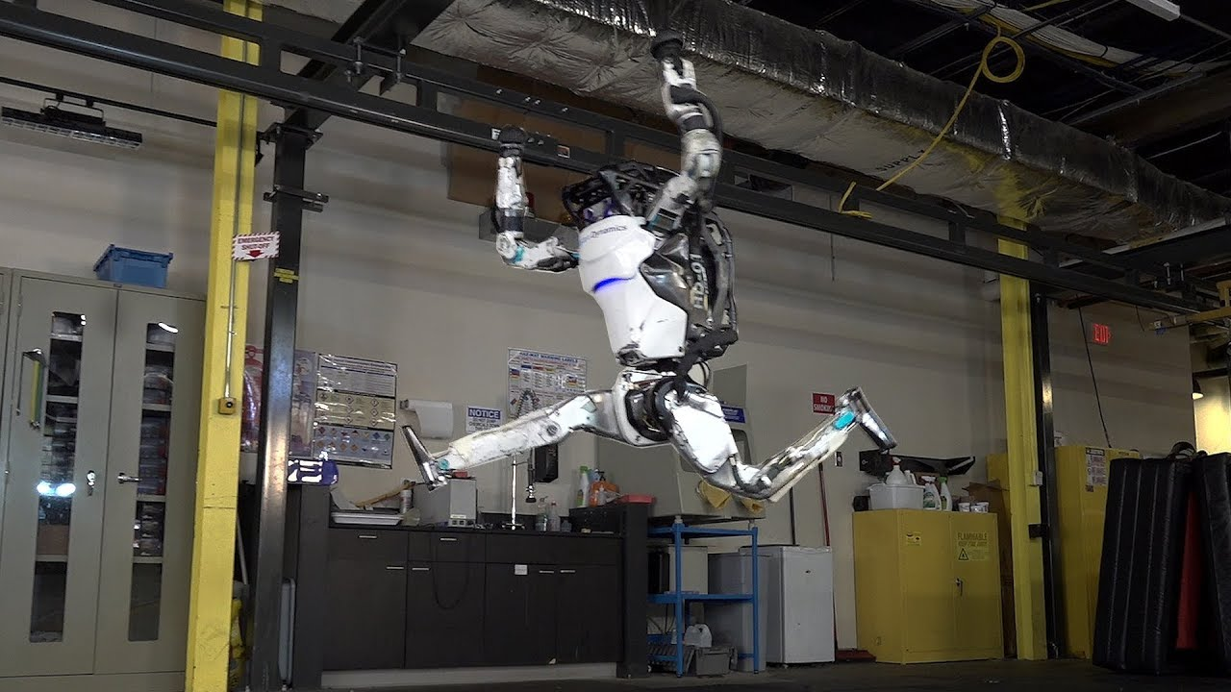
Workout Time!
Python 3 Beginner
Chapter 2 Exercises link
Notes:
https://github.com/cstar-industries/python-3-beginner/blob/master/001-First-Steps/First%20Steps%20-%20Chap%2002%20-%20Exercises.ipynb

Slide 26
Chapter Summary
Python 3 Beginner
This chapter covered the following:
Basic numeric types in Python: int and float
Simple math operations using operators
Order of operations in Python
Complex number type
Deeper math functions from the math module

Slide 27
Python 3 Beginner
Chapter 03
Data types and operators: Part II
release 1.0.0
37/39 Avenue Ledru Rollin – CS 11237 – 75750 PARIS CEDEX 12 - info@valnaos.com – www.valnaos.com Tél : 01 86 95 20 48

Slide 28
Handling text in Python
Python 3 Beginner
Text data type: str (string)
Strings are any arbitrary text enclosed between single or double quotes
"Hello"
'World’
Special characters can be input using “escape sequences”
\n, \t, etc.
\x41, \u262d

Slide 29
Let’s write some code!
Python 3 Beginner
opening_line = 'It was a bright cold day in April, and the clocks were striking thirteen.'
print(opening_line)
It was a bright cold day in April, and the clocks were striking thirteen.

Slide 30
Operations on Python strings
Python 3 Beginner
Concatenation: +
"spam" + "eggs"
spameggs
Repetition: *
5 * "spam "
spam spam spam spam spam
Length: len
len("hello")
5

Slide 31
Anatomy of a string
Python 3 Beginner
A Python string is a list (string) of characters.
S | p | a | m | ⎵ | & | ⎵ | e | g | g | s
0
1
2
3
4
5
6
7
8
9
10
11
The string "Spam & eggs" is shown above as an array of characters
The length of the string is 11 characters
Each character can be referred to by its index
Notes:
What is the index of the first character?
What is the index of the last character?
How does that relate to the length of the string?
What is character [4]?

Slide 32
Let’s write some code!
Python 3 Beginner
print(3 * "spam, " + "and eggs")
spam, spam, spam, and eggs

Slide 33
The str type
Python 3 Beginner
The str type has many methods.
A method is “something that the variable can perform” (a function bound to an object).
Change casing: upper, lower, title
Change whitespace: strip
Extract words: split

Slide 34
Type conversions
Python 3 Beginner
A type can sometimes be converted to another type.
Write the type name, followed by the value between parentheses:
a = int("12")
print(30 + a)
42
print("9 + 3 = " + str(12))
9 + 3 = 12

Slide 35
Format strings
Python 3 Beginner
Format strings provide a concise and readable way to mix variables, expressions and literal strings
age = 12
print(f"My brother is {age} years old.")
My brother is 12 years old.
a = 12
print(f"{a} squared is {a*a}")
12 squared is 144

Slide 36
Let’s write some code!
Python 3 Beginner
int("deadbeef", 16)
3735928559

Slide 37
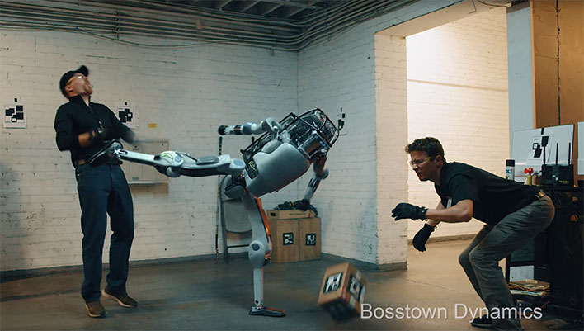
Workout Time!
Python 3 Beginner
Chapter 3 Exercises link
Notes:
https://github.com/cstar-industries/python-3-beginner/blob/master/001-First-Steps/First%20Steps%20-%20Chap%2003%20-%20Exercises.ipynb

Slide 38
Chapter Summary
Python 3 Beginner
This chapter covered the following:
Python’s text type: str
Indexing, length and ranges of strings
str has methods (remember this word)
Converting between types
Using format strings to produce readable code that outputs variables mixed with literal text.

Slide 39
Cloud Technology Associate
Copyright © 2018 | 9
Q&A
37/39 Avenue Ledru Rollin – CS 11237 – 75750 PARIS CEDEX 12 - info@valnaos.com – www.valnaos.com Tél : 01 86 95 20 48

Slide 40
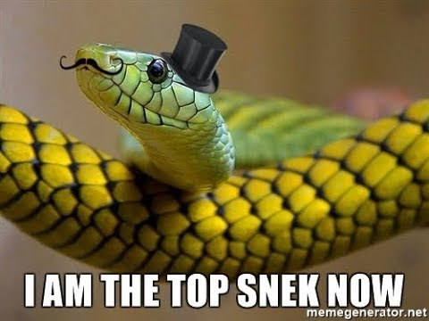
Workshop
Python 3 Beginner
Session 1 Workshop link
Notes:
https://github.com/cstar-industries/python-3-beginner/blob/master/001-First-Steps/First%20Steps%20-%20Workshop.ipynb

Slide 41
Thank you for your attention!

